Slide 1

Risk Management
Predict – Preempt – Protect

Slide 2
Risk Management
Process of identifying and assessing risk, reducing it to an acceptable level
Risk Analysis
The process by which the goals of risk management are achieved
Includes examining an environment for risk, evaluating each threat event to its likelihood and the cost of damage, creating cost/benefit report for safeguards to present to management.
NIST 800-39 defines 3 tiers of risk management
Organizational tier – Concerned with the risk to the business as a whole
Business process tier – Deals with a major function within the organization
Information Systems tier – Addresses risk from a information system perspective

Slide 3
Risk Terminologies
Asset
Anything that has value
Threat
Any potential occurrence that may cause an undesirable outcome on the asset
Threat Agent
The entity that takes advantage of the vulnerability
Risk
Vulnerability
Weakness in an asset or absence/weakness in the control measure
Exposure
Being susceptible to asset loss due to threat; instance of threat taking advantage of vulnerability; always measured in %
Likelihood threat will exploit the vulnerability; Risk = Threat * Vulnerability*impact
Safeguard
Anything that removes or reduces a vulnerability or protects against threat

Slide 4
Information Systems Risk Management Policy
Should be a subset of Overall Risk Management Policy
It provides the foundation and direction for organizations security and risk management process and procedures
Should address the following
Objectives of ISRM Team
Risk appetite
Formal process for Risk identification
Connection between ISRM and Organization’s strategic planning process
Roles and Responsibilities of ISRM Team
Mapping of Risk to Internal controls
Mapping of Risk to performance targets
Key indicators to monitor the effectiveness of controls

Slide 5
Risk Management Process
4 Interrelated components that comprise the risk management process
Frame Risk:
Defines the context within which all risk activities takes place
Assess Risk:
Most critical aspect of the process; assessing the risks to determine mitigation strategies
Respond to Risk:
Determining the risk response options available
Monitor Risk:
Continuously monitor the effectiveness of controls against the risks as well as look for new risks.

Slide 6
Risk Analysis
Risk Assessment – Method of identifying vulnerabilities and threats and assessing the possible impacts to determine where to implement the security controls
Risk Analysis
Carried out after risk assessment; ensures security is cost-effective, relevant, timely and responsive to the threats
Helps prioritize risks and shows management the amount of resources needed to protect in a sensible manner
4 main goals of risk analysis
Identify Assets and their values to the organization
Identify vulnerabilities and threats
Quantify the probability and business impact of these potential threats
Provide cost benefit analysis of the safeguard
Risk Analysis must be supported and directed by senior management
Management must define the purpose and scope of analysis, appoint a team to carry out assessment and allocate necessary resources
Risk Analysis helps integrate the security objectives with the business objectives

Slide 7
1. Asset Valuation
Aspects to consider when assigning value to the assets
Cost to acquire or develop
Cost to maintain and protect
Value to owner and users
Value to adversaries
Price others are willing to pay
Cost to replace the asset if lost
Operational and production activities affect if the asset is not available
Liability issues if the asset is compromised
Usefulness and role of the asset in the organization

Slide 8
Asset Valuation - Benefits
Helps in performing effective cost/benefit analysis
Helps select specific countermeasures and safeguards
Determine the level of insurance coverage to purchase
Understand what exactly is at risk
Comply with legal and regulatory requirements

Slide 9
Identifying Vulnerability and Threats
Loss Potential
What the company will loose if a threat agent actually takes advantage of a vulnerability
Eg: data corruption, destruction, information disclosure
Delayed Loss
Its is secondary in nature and takes place well after a vulnerability is exploited
May include damage to reputation, loss of market, accrued penalties etc.

Slide 10
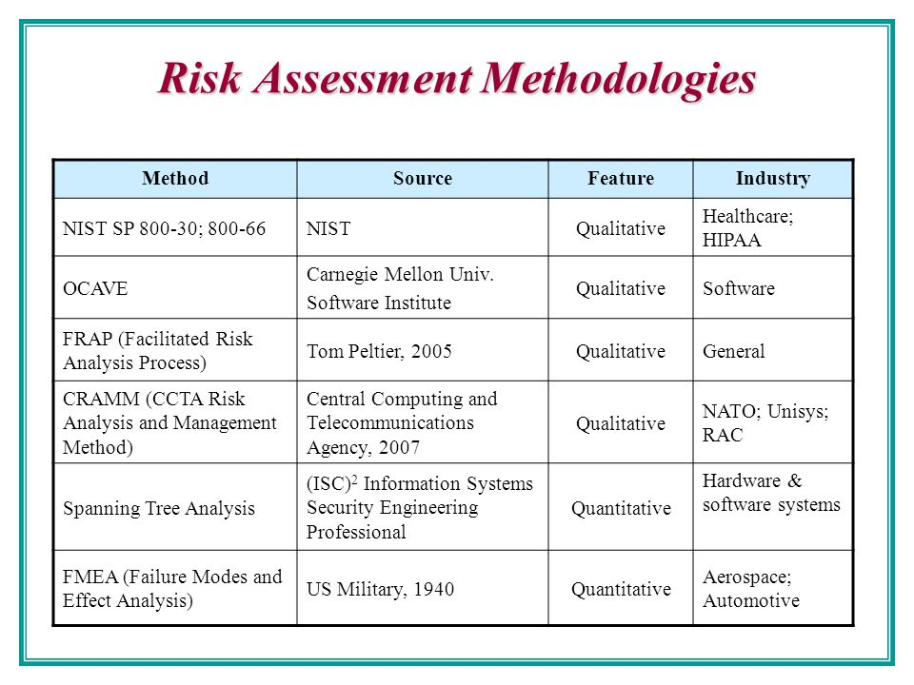
Risk Assessment Methodology
We will cover the following methodologies
NIST 800-30
Facilitated Risk Analysis Process (FRAP)
OCTAVE
AS/NZS 4360
Failure modes and Effects analysis (FMEA)
Fault Tree Analysis
CRAMM

Slide 11
NIST 800-30
Focused on Computer systems and IT security issues
Establishes a 6 step Risk Management framework for Federal Systems
Categorize the information system
Select the security controls
Implement security controls
Assess security controls
Authorize the information system
Monitor the security controls

Slide 12
FRAP - Facilitated Risk Analysis Process
Focuses only on systems that really need assessing, to reduce cost and time obligations.
Stresses pre-screening activities so that RA steps are carried only on items that need it most
Used to analyse one system, application or business process at a time
It does not support the idea of calculating exploitation probability or ALE
Goal is ensure efficiency and cost effectiveness by keeping the assessment scope simple and small

Slide 13
OCTAVE
Intended to be used in situations where people manage and direct the risk evaluation within their organization
Relies on idea that people working in the organization are best positioned to understand Risk and what is needed to address them.
The scope of the Assessment is very wide than FRAP
The individuals perform assessment via facilitated workshops

Slide 14
AS/NZ 4360
Takes a broader approach to Risk management
This risk methodology is more focussed on the health of the company from a business point of view than security
It can be used to understand the company financial, capital, human, and business decision risks

Slide 15
Failure Mode and Effects Analysis (FMEA)
Method of identifying (in a structured way)
Functions
Functional Failures
Cause of failure
Effects of failure
This is commonly used in product development and operational environments
Goal is to identify failure points and either fix or reduce the impact of the failure
It is used in Assurance Risk Management because of the level of detail, variables and complexity
This is not useful to detect complex failure modes involving multiple systems

Slide 16
Fault Tree Analysis
Most useful approach to identify failures in more complex environments and systems
An un-desired effect is taken as the root and events that can contribute to this effect are added as a tree
Some common software failures that can be explored
False alarms
Insufficient error handling
Sequencing or order
Incorrect timing outputs
Valid but not expected outputs

Slide 17
CRAMM
Created by UK and its automated tools are sold by Siemens
Works in three distinct stages
Define objectives
Assess risks
Identify countermeasures
It is a completely automated way of Risk Assessment

Slide 18
Risk Analysis Approaches

Slide 19
Quantitative Risk Analysis
Assigns monetary and numeric values to all elements of the Risk analysis process
More scientific or mathematical approach to Risk Assessment
Uses risk Calculations to attempt to predict the level of monetary loss, and the probability for each type of threat
The reports are fairly user friendly
However, not all elements can be quantified

Slide 20
Quantitative Risk Analysis – 6 Steps
Assign Asset value
Calculate Exposure Factor
Derive Annualized Loss Expectancy
Calculate Single loss Expectancy
Assess Annualized Rate of Occurrence
Perform Cost/Benefit Analysis of Counter measure

Slide 21
Key Terms in Quantitative Analysis
Exposure Factor
(EF)
% loss the organization would suffer if a risk materializes
Also referred to as loss potential
Single Loss Expectancy
(SLE)
Cost associated with a single realized risk against a specific asset
SLE = AV * EF
Annualized Rate of Occurrence
(ARO)
Frequency with which a specific threat will occur within a single year
Range from 0 (threat will not occur) to very large numbers
It is calculated in $ value
It is also known as probability determination
Annualized Loss Expectancy
(ALE)
Possible yearly cost of all instances of a specific threat realized against a specific asset
ALE = SLE * ARO
Annual Cost of Safeguard
(ACS)
It’s the cost associated in procuring, developing, maintaining a control against a potential threat
The ACS should not exceed the ALE

Slide 22
Cost Benefit Analysis
ALE before Safeguard – ALE after Safeguard – Cost of Countermeasure = Value of the safeguard to the company
If the above result is negative the safeguard is not financially reasonable to be implemented
It is also important to consider the issues of legal responsibility and prudent due care

Slide 23
Qualitative Risk Analysis
Uses a softer approach to Risk analysis
It does not quantify the data, does not use calculations
It is more opinion and scenario based and uses rating system
Techniques include judgement, best practices, intuition, and experience
Methods
Brainstorming, Delphi technique, storyboarding, focus groups, surveys, questionnaire, checklists, one-on-one meetings, Interviews

Slide 24
Qualitative Risk Analysis Methods
Brainstorming
A group decision-making technique designed to generate a large number of creative ideas through an interactive process.
Delphi Technique
Delphi is based on the principle that decisions from a structured group of individuals are more accurate than those from unstructured group
The experts answer questionnaires in two or more rounds. After each round, a facilitator provides an anonymous summary of the experts’ decision from the previous round as well as the reasons they provided for their judgments
Storyboarding
Processes are turned into panels of images depicting the process, so that it can be understood and discussed
Focus Groups
Panels of users evaluate the user impact and state their likes and dislikes regarding the safeguard being evaluated
Surveys
Used as an initial information gathering tool. Results of each survey can influence the content of other evaluation methods
Questionnaires
Limit the responses of participants more than surveys, so they should be used later in the process
Checklist
Used to make sure safeguards being evaluated cover all aspects of the threats

Slide 25
Qualitative vs Quantitative
Qualitative
Requires no calculations
Provides general areas and indications of risk
Quantitative
Does more complex calculations
Mathematical and statistical calculations
Involves high degree of guess work
Uses independently verifiable and objective metrics
Does not allow Cost/benefit analysis
Allows cost/benefit analysis
Based on opinions of individuals
It is easier to automate
Used in Risk management performance tracking
Without automated tools, the process is very difficult
More preliminary work is needed to gather detailed information about the environment
Eliminates the opportunity to create a dollar value for Cost/benefit analysis
Hard to develop a security budget from the results

Slide 26
Countermeasure/Safeguard Selection
Modularity
Should provide uniform protection
Provide override functionality
Default to least privilege
Flexibility and security
Should not panic users
Clear distinction between user and admin
Minimum human intervention
Easily upgraded
Auditing functionality
Output should be in useable format
Testable
Should not introduce new compromise
System and user performance

Slide 27
Total Risk vs Residual Risk
Total Risk = Threats * Vulnerability * Asset Value
Residual Risk = (Threats * Vulnerability * Asset Value) * control gaps
Residual Risk = Total Risk – countermeasures

Slide 28
Handling Risk
Reduce or Mitigate the risk
Implement safeguards to eliminate or vulnerabilities or block threats
Risk Assignment or Transfer
Placement of the cost of risk to another entity
Risk Acceptance
Conscious decision to live with the risk
Risk Rejection or Ignore
Unacceptable response to risk is reject or ignore the risk
Risk Avoidance
Terminate the activity that is introducing the risk

Slide 29
Control Categories
Administrative control
Logical control
Physical control
Administrative Control
Policies and procedures defined by an organization
Also referred as management controls
Technical control
Involves the hardware and/or software mechanisms used to manage and provide protection
Eg: firewall, password, biometric, authentication systems, IDS, routers, AV
Physical Control
Physical mechanisms deployed to prevent, monitor, detect contact with systems or facilities
Eg: guards, fences, CCTV, dogs, mantraps, alarms
Focuses on personnel and business practices
Eg: policy, Hiring practice, training, Data classification.

Slide 30
Control Types
Deterrent
Discourage violation
Deployed against individuals
Preventive
Stop unwanted or unauthorized action
Fences, locks, biometrics, encryption, firewall
Policy, locks, fences, guards, dogs
Detective
Deployed to discover unwanted or unauthorized action
Operates after the fact
CCTV, Audit logs, Job rotation, Mandatory vacation, IDS
Compensating
Any control used in addition to or in place of another control
Usually implemented if the primary control cannot be implemented or exceeds the ALE
Corrective control
Modifies the environment to return systems to normal state after an unwanted activity
Attempts to correct any problem that has occurred
AV, back and Format
Recovery control
Extension of corrective control but have more advanced abilities
Backup and restore, fault tolerance, system imaging, clustering, VM Shadowing
Directive Control
Deployed to direct, confine or control actions of the subjects on the object
ATM, posters, monitoring, supervision

Slide 31



